Slide 1
Mydoom virus
Suleymanov Fuad
Abbasov Afgan
Mammadli Omar
Haciyev Salim
Masmaliyev Tahar
Babayev Orkhan

Slide 2
Table of Contents
Techncial details
03
01
What is MyDoom?
02
How does Mydoom work?
04
Variants of MyDoom
05
Prevention and Removal process

Slide 3
What is Mydoom ?
Mydoom is a computer worm affecting the Microsoft Windows operating system that was first discovered in January 2004. After analysis of its source code, the worm’s function was determined to be twofold: it installed a backdoor on TCP port 3127, and launched a scheduled denial-of-service (DoS) attack against the website of SCO Group on February 1, 2004.
It has been blamed for several major slowdowns in internet traffic as the worm spread through infected computers.

Slide 4
Also known as
W32.MyDoom@mm,
Novarg,
Mimail.R,
Shimgapi
-First Sighted on January 26, 2004
-Created in Russia, Original author(s) unknown
-Set a new record as fastest spreading e-mail worm
It's name came from a section of the virus file

Slide 5


How does MyDoom work?
MyDoom (also known as Novarg, W32.MyDoom@mm, Shimgapi, and Mimail.R) spreads through malicious email attachments. After the victim clicks on the attachment, the worm gets inside their operating system and sends emails to all the victim’s contacts. When people see a familiar name, they are more likely to open a suspicious file.
At the time of discovery in 2004, you could also get MyDoom by using the file-sharing platform Kazaa, which is no longer operating.
MyDoom adds infected computers to a botnet and then carries out distributed denial of service (DDoS) attacks. When the worm takes control over the victim’s OS, it then opens various ports and provides a backdoor to invite even more malware in.

Slide 6
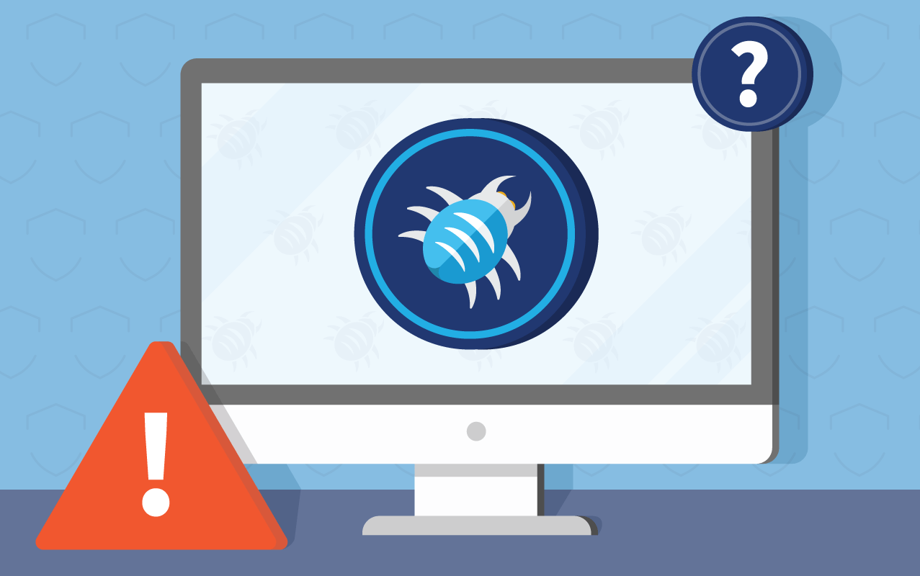
Technical details
MyDoom arrives with one of the following subject lines: test, hi, hello, mail delivery system, mail transaction failed, server report, status, or error. According to cybersecurity experts, the malicious email attachments typically contain pif, exe, cmd, bat, txt, doc, and zip extensions.
When MyDoom is executed, it copies itself to the %system% or %temp% directories. The worm also creates a registry value in one of the following keys:
HKEY_LOCAL_MACHINE\Software\Microsoft\Windows\CurrentVersion\Run
HKEY_CURRENT_USER\Software\Microsoft\Windows\CurrentVersion\Run

Slide 7
Technical details (2)
This causes the worm to start whenever you launch your Windows computer. MyDoom also deploys a backdoor Trojan, allowing unauthorized access to your system, and copies itself to P2P to spread through downloads. After all of this is done, an infected device turns into a so-called zombie — a remotely controlled machine that can be used in DDoS attacks.

Slide 8

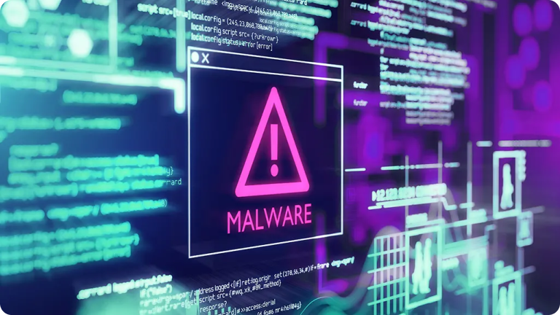
Variants of Mydoom
The first version of MyDoom was called MyDoom.A, followed by MyDoom.B, which additionally modified the host file of an infected computer to prevent the use of antimalware software.
However, MyDoom.B did not spread as fast as the previous variant. When it launched a DDoS attack against Microsoft in 2004, the botnet was not big enough to take down the site.
A bunch of other MyDoom variants – C, F, G/H, U, V, W, X – were spotted in the wild later, but none achieved the notoriety of the A variant.

Slide 9

Prevention and Removal of the virus
Prevention If you receive MyDoom.m, do not open the attached file. The best way to prevent infection is to make sure that your antivirus signature files are current. Also, a personal firewall will prevent the virus author from gaining remote access to your PC.
Removal Most antivirus software companies have updated their signature files to include this worm. This will stop the infection upon contact and in some cases will remove an active infection from your system.

Slide 10
Resources:
https://www.okta.com/identity-101/mydoom/
https://www.zdnet.com/article/mydoom-the-15-year-old-malware-thats-still-being-used-in-phishing-attacks-in-2019/
https://www.techopedia.com/definition/27497/mydoom#:~:text=Mydoom%20works%20by%20targeting%20a,as%20email%20attachments%20in%20turn
https://www.radware.com/security/ddos-knowledge-center/ddospedia/mydoom/
https://nordvpn.com/blog/mydoom-virus/

Slide 11


